Slide 1





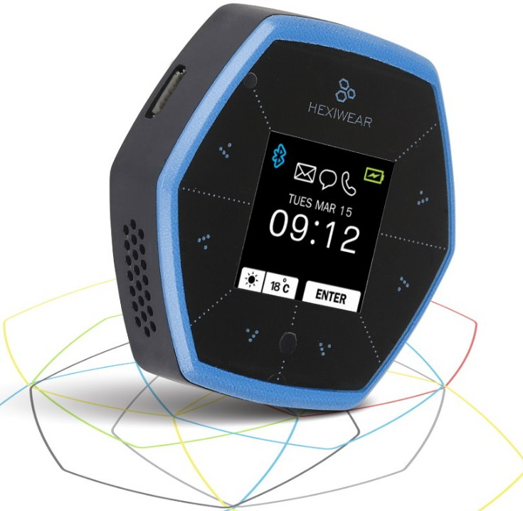
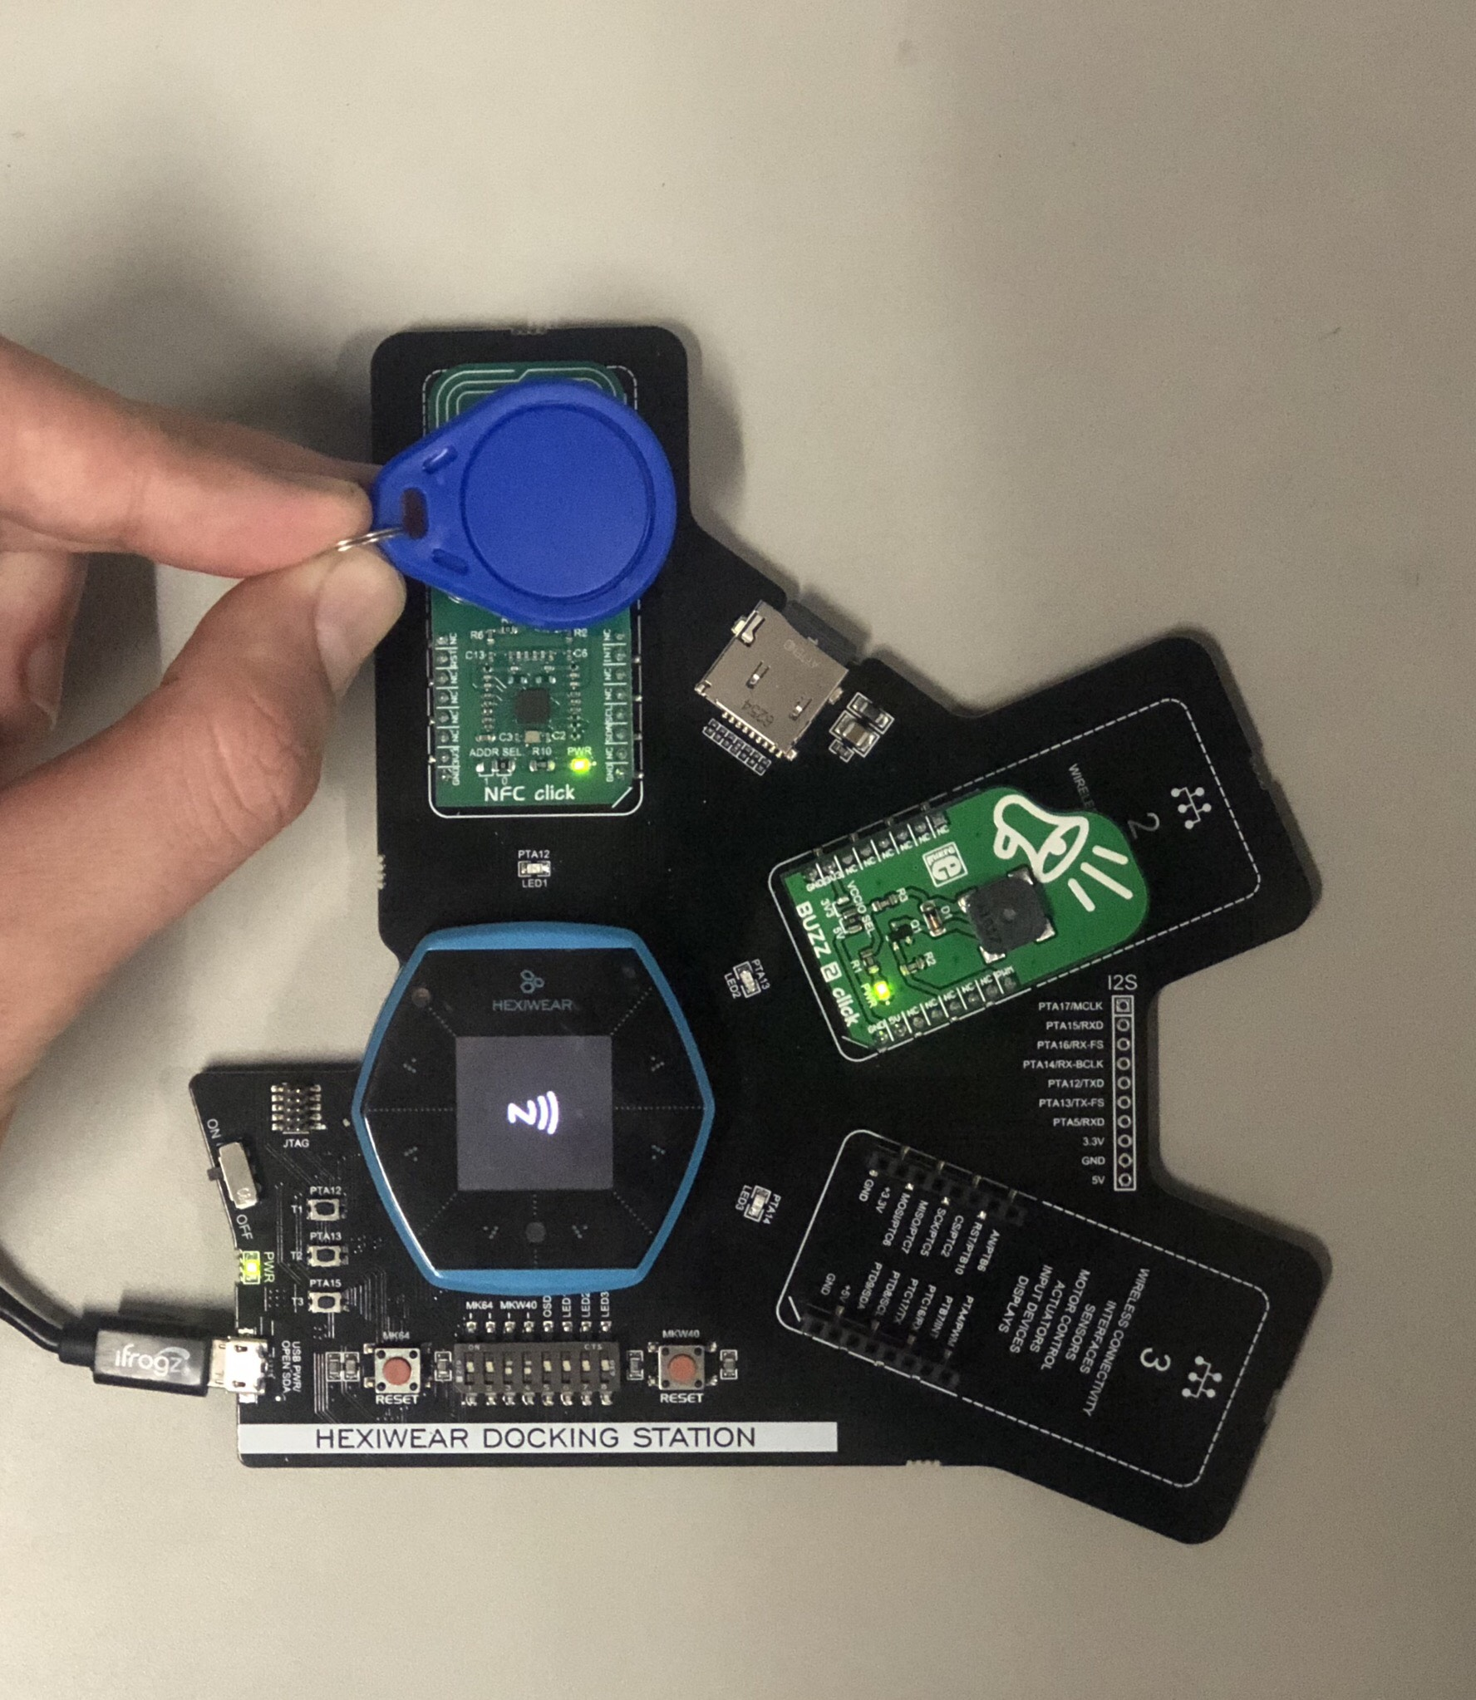


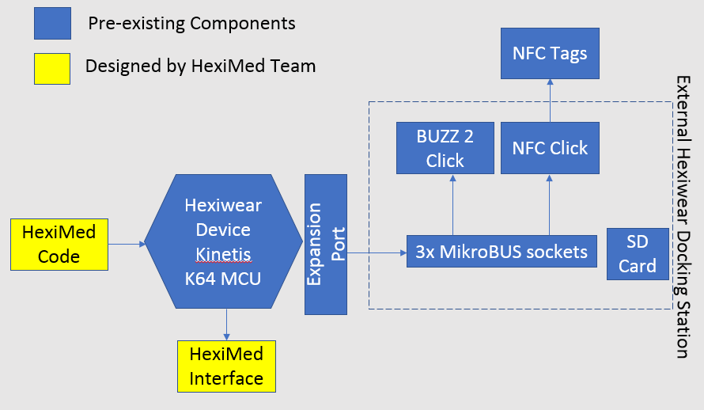
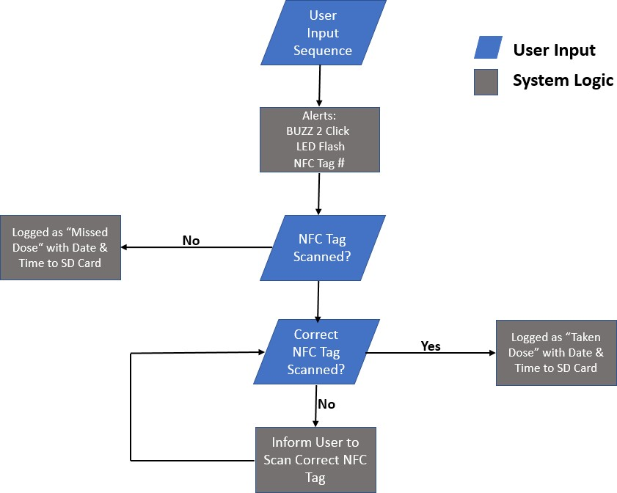




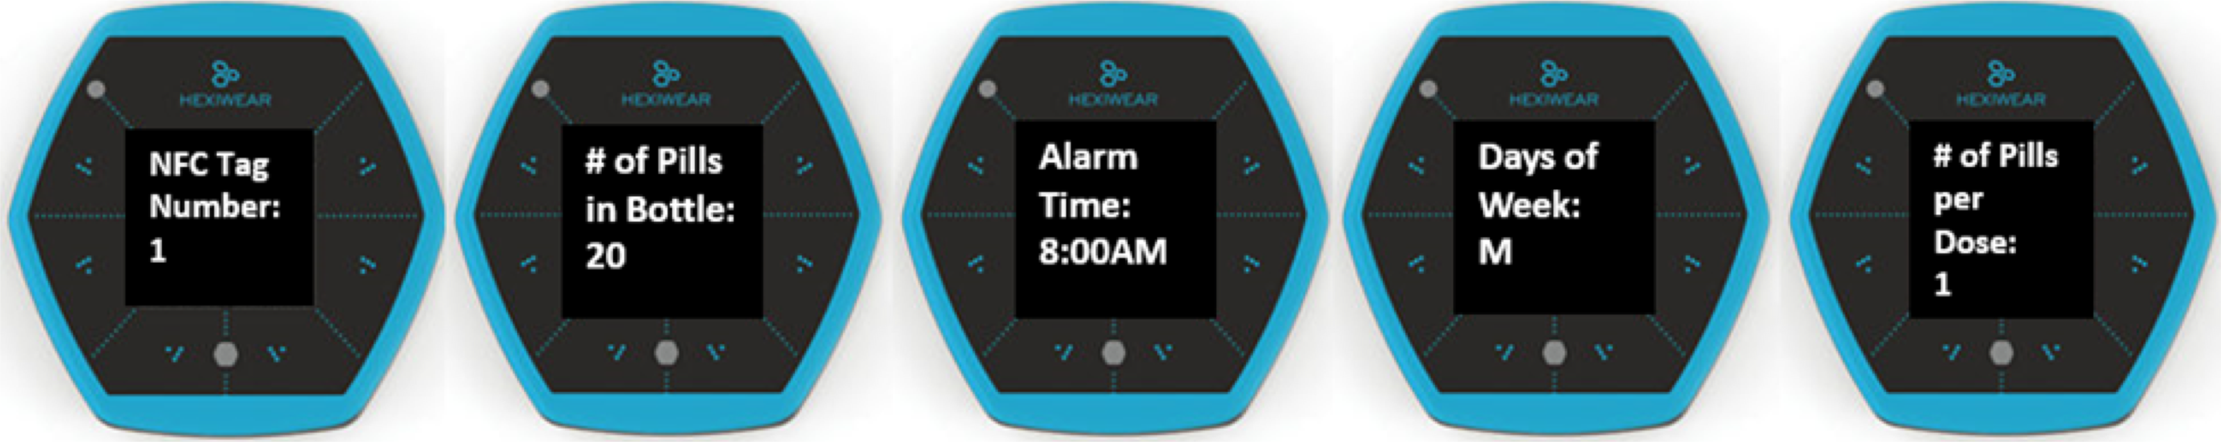
1.7 Hexiwear IoT Team Lambda - HexiMed
Sponsor: NXP Semiconductors
Team Members
Project Features & Components
Project Outcome
Feature Function
User Input User will input medication information on the Hexiwear device
Visual and Matrix RGB Click and BUZZ 2 Click will Sound prompt user to take their medications at the ^{Alarm} correct times
Medication NFC Tags will be attached to pill bottles to Tracking track each time medication is taken
Medication Data from NFC Tags will be stored on to an History SD card to create a medication log
Hexiwear
Hexiwear Docking Station
BUZZ 2 Click
NFC Click
NFC Tags
Project Manager Vanessa Yanez
Franco Justo
Interfaces:
1.1” OLED Hexiwear Screen
Audio Alarm
NFC Tags
Memory Card
Project Motivation
Conclusion
Kelly Carranza
Michael Harmon
Design Approach
Project Description
HexiMed is an IoT connected medication reminder that functions to:
Notify a patient when to take proper medications by use of visual and sound alarm
Seeks to improve medication adherence by establishing an organized medication schedule
Provide a medication log stored on to a SD card to be accessed by a physician, caregiver, or patient
Results
Project Motivation
Lack of medication adherence is estimated to cause 125,000 deaths per year
Costs between $100-$289 billion a year to tax payers
People typically take only half of prescribed doses
Project Motivation
User Input Sequence:
Acknowledgements
Senior Design Instructors: Dr. Cecil Compeau & Mr. Lee Hinkle
Faculty Advisor: Dr. Semih Aslan
NXP Sponsor: Dr. Kevin Kemp
Senior Design II Mentor: Mr. Alex Song
Administrative Assistant: Ms. Sarah Rivas

